Slide 1
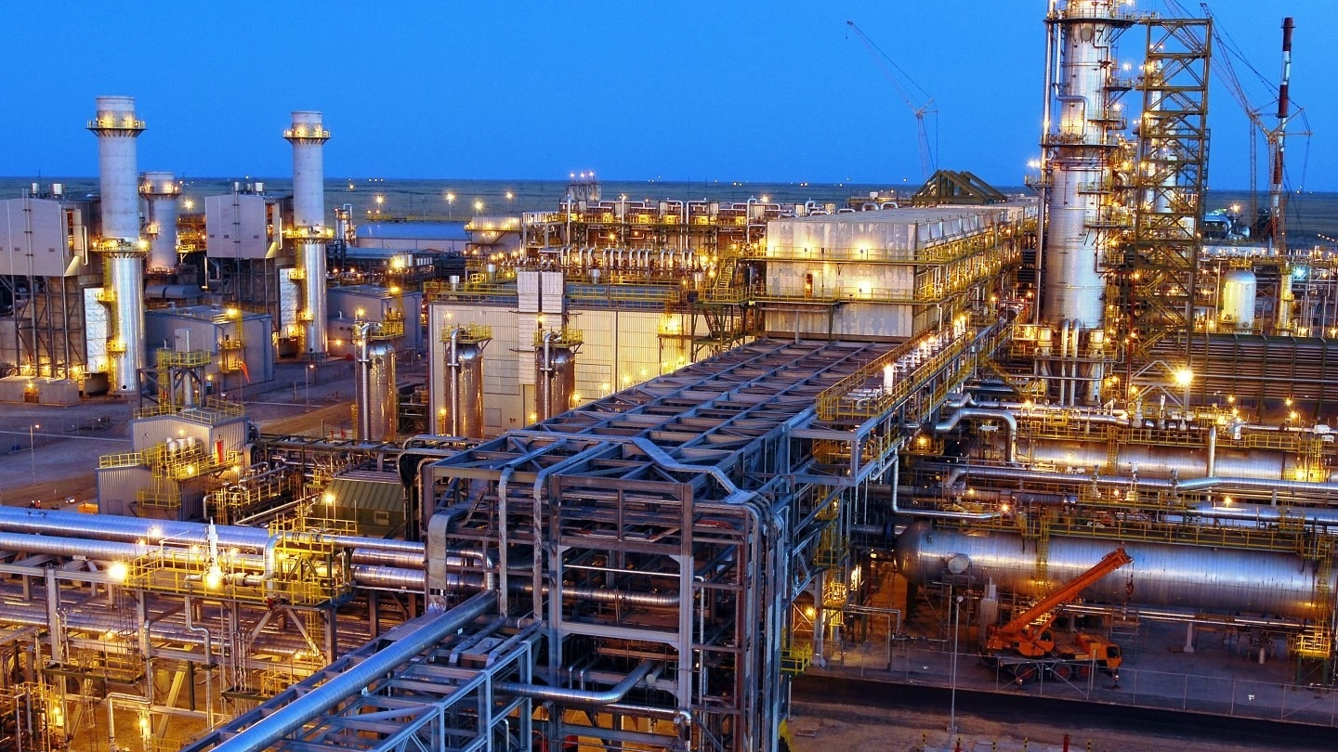
How Oil Export Performance Influences GDP Growth in Kazakhstan
by
Nurym Kussaiyn

Slide 2
Problem Statement & Literature Review
Kazakhstan's economy is heavily dependent on oil exports, which account for a significant share of GDP and government revenue. However, fluctuations in global oil trend and production volumes lead to instability in national economic growth. Understanding this relationship is critical for sustainable economic planning.
How strongly does Kazakhstan’s GDP growth depend on oil export performance?
Literature:
Ministry of Energy of the Republic of Kazakhstan

Slide 3
Dataset & Metadata Description
World Bank – Gross Domestic Products: data
U.S. Energy information administration - crude oil production by country EIA data

Slide 4
Hypothesis Statement
Null hypothesis (H₀): GDP growth is independent of oil exports.
Alternative hypothesis (H₁): GDP growth significantly depends on oil production.

Slide 5
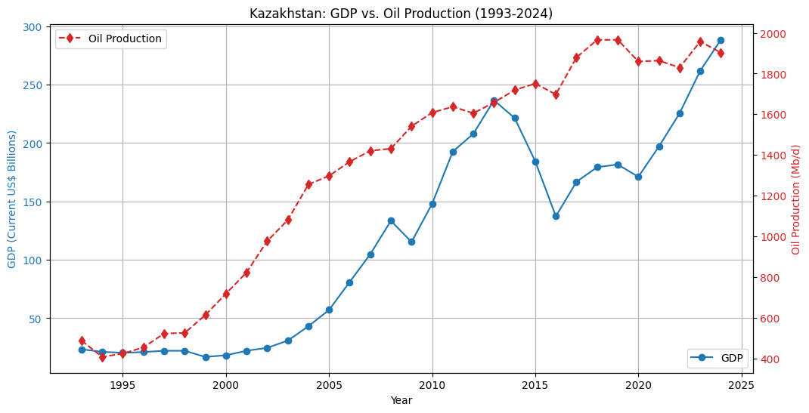
Line chart of Kazakhstan’s GDP and oil export value (1993–2024).
Line chart of Kazakhstan’s GDP and oil export value (1993–2024).
Observation: both rise and fall together — especially in 2008 (crisis), in 2016 (oil price drop) and 2020 (COVID-19).

Slide 6
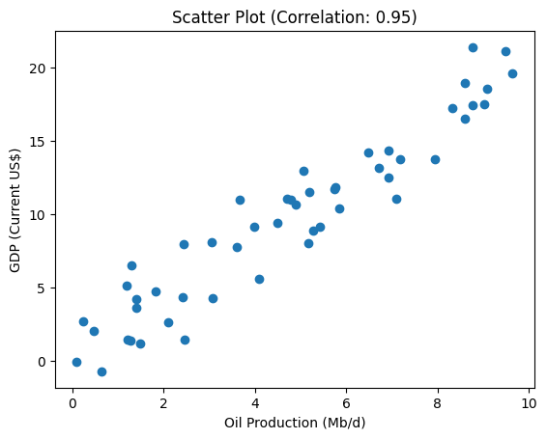
Correlation Analysis
Scatter plot: Oil exports vs. GDP (Correlation 0.95).
Regression line shows 1 Mb/d rise in production → significant GDP gain.

Slide 7
Conclusion
Based on this data, Kazakhstan's economic fortune is heavily dependent on its oil production. The near-perfect correlation shows that the country's GDP rises and falls almost directly in line with how much oil it produces.

